Slide 1
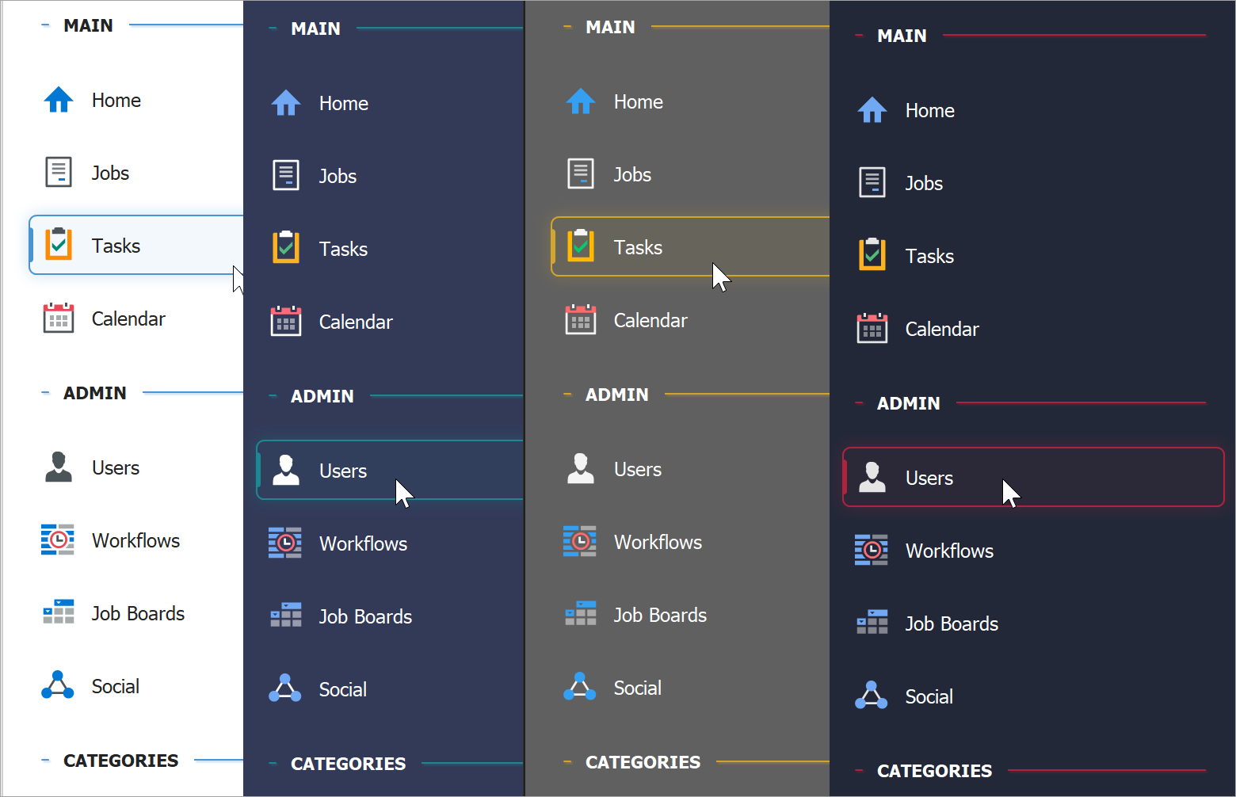
my
To-do list
web app
The project of
Information & communication technologies
Group members: shaheer jamal – 017 Dua Fatima – 032 namirah Imran – 033 kashaf khan - 018

Slide 2
my
To-do list
web app
The project of
Information & communication technologies
Group members: shaheer jamal – 017 Dua Fatima – 032 namirah Imran – 033 kashaf khan - 018

Slide 3
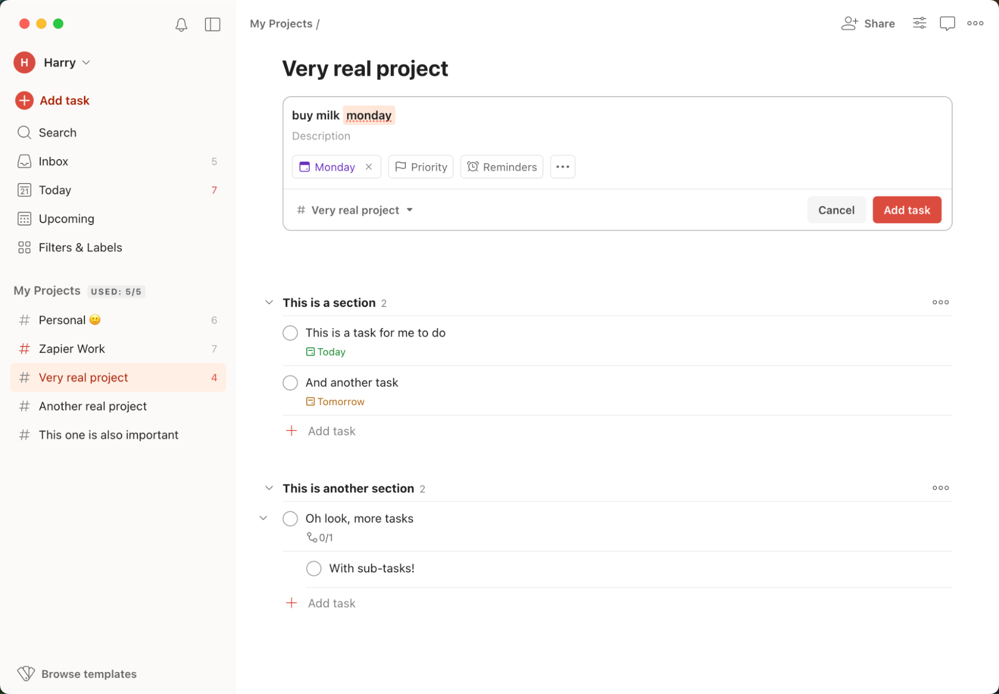
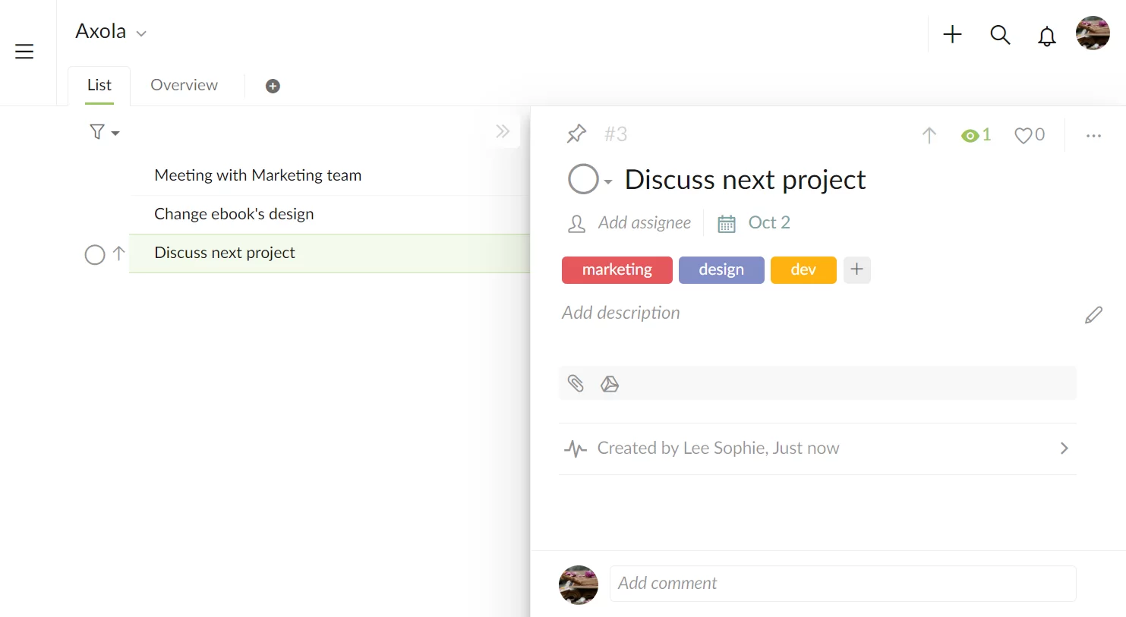
1
2
PROJECT PURPOSE
INTRODUCTION OF THE PROJECT
This project is a simple and useful web app called To-Do List. It helps users keep track of their daily tasks in one place. You can add new tasks, mark them as completed, and delete them when done. It also lets you set the priority level of tasks like low, medium, or high. The app is designed with a clean look and works on all screen sizes. It also includes filters to show all tasks, only completed ones, or only pending ones. There is also a dark mode to make it easier to use at night. The goal is to make task management simple and digital.
The purpose of this project is to help people manage their daily tasks better. Many people forget their to-dos or lose track of them. This app gives a digital way to remember everything in one place. It replaces the need for writing on paper and makes it easier to add and check tasks quickly. The app also helps users focus on important tasks by setting priority levels. It was created to solve the common problem of task management using easy and modern tools. It also gives practice in using real programming and design skills.

Slide 4
1
2
PROJECT PURPOSE
INTRODUCTION OF THE PROJECT
This project is a simple and useful web app called To-Do List. It helps users keep track of their daily tasks in one place. You can add new tasks, mark them as completed, and delete them when done. It also lets you set the priority level of tasks like low, medium, or high. The app is designed with a clean look and works on all screen sizes. It also includes filters to show all tasks, only completed ones, or only pending ones. There is also a dark mode to make it easier to use at night. The goal is to make task management simple and digital.
The purpose of this project is to help people manage their daily tasks better. Many people forget their to-dos or lose track of them. This app gives a digital way to remember everything in one place. It replaces the need for writing on paper and makes it easier to add and check tasks quickly. The app also helps users focus on important tasks by setting priority levels. It was created to solve the common problem of task management using easy and modern tools. It also gives practice in using real programming and design skills.

